Slide 1
Willson Financial Database Design Solution

Slide 2

01
Nima Memarzadeh: Python scripting for generating reports.
02
Brian Preston: Refining the presentation and group coordination.
Group Introduction
03
Anton DeCesare: Drafting and initial presentation structure.
04
Brett Fuller: Database design and ERD updates.
05
Samir Rodriguez: Data population and testing.

Slide 3

Case Study Overview
Willson Financial Overview
Willson Financial, founded by Jake and Ned Willson, provides financial advisory services to a diverse community in New Mexico, including ranchers, farmers, and retirees.
Challenges
Managing growing client data, ensuring compliance with SEC regulations, and generating actionable insights for decision-making are significant challenges.
Proposed Solution
Our goal was to create a robust database system supporting streamlined operations, enhanced decision-making, and scalable infrastructure for future demands.

Slide 4
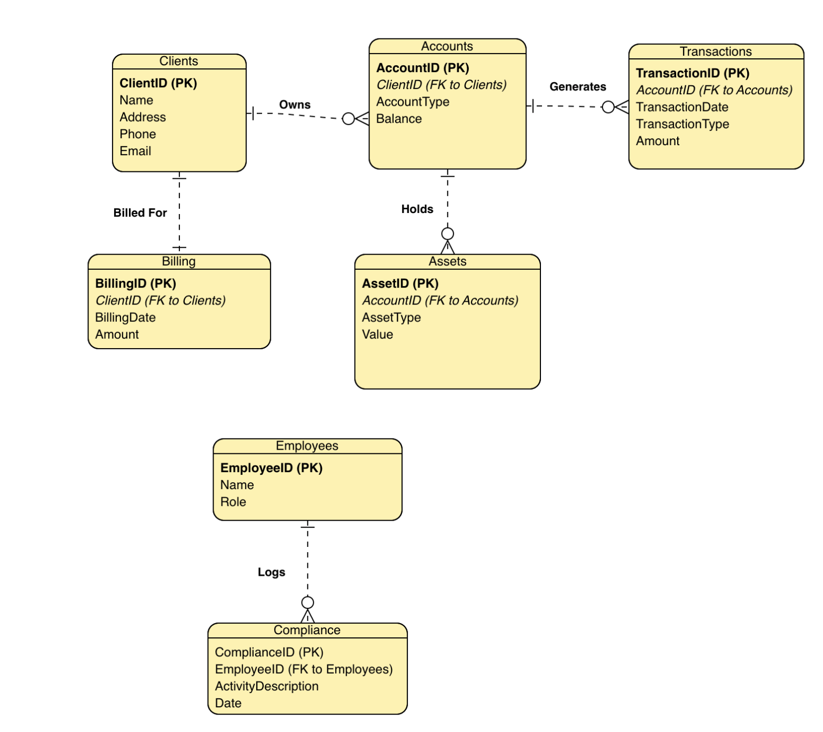
Finalized ERD

Slide 5
Reports Generated
Clients Added in the Last Six Months
High-Transaction Clients
Scalability Insights
Monitor client growth trends. Example: 'June: 5 clients, July: 7 clients.'
Identify clients with >10 transactions in a single month. Example: 'Alice Smith: 12 transactions in December 2024.'
Generate insights into resource allocation and future demands.

Slide 6
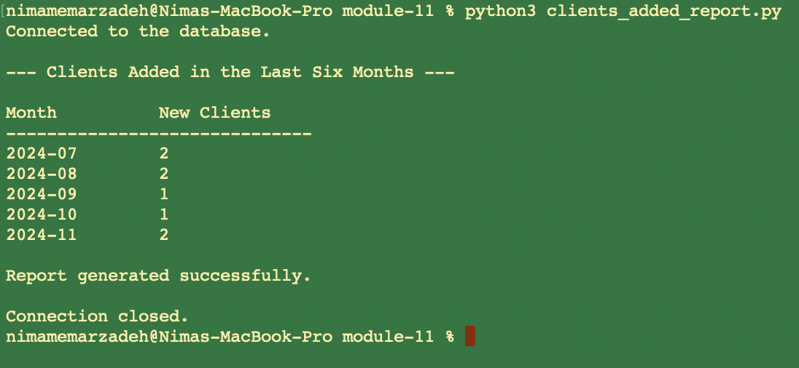
Clients Added in the Last Six Months

Slide 7
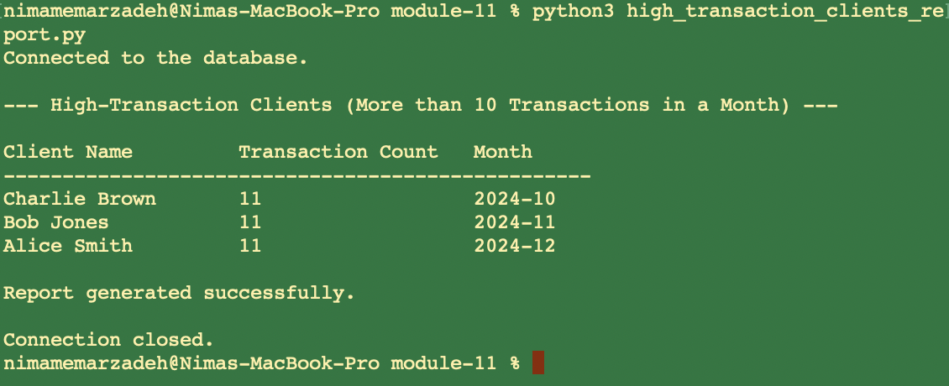
High-Transaction Clients

Slide 8

Scalability Insights

Slide 9
Our database design was guided by assumptions such as unique client details, digital transactions, monthly billing cycles, categorized assets, high-transaction definitions, and strict data constraints to ensure integrity.
Assumptions
Key Assumptions

Slide 10
Database Scalability and Compliance
How does our solution align with your expectations?
Conclusion
Our robust database solution equips Willson Financial to manage operations efficiently, meet compliance standards, and deliver detailed insights. We welcome feedback on scalability and adaptability.

